Slide 1
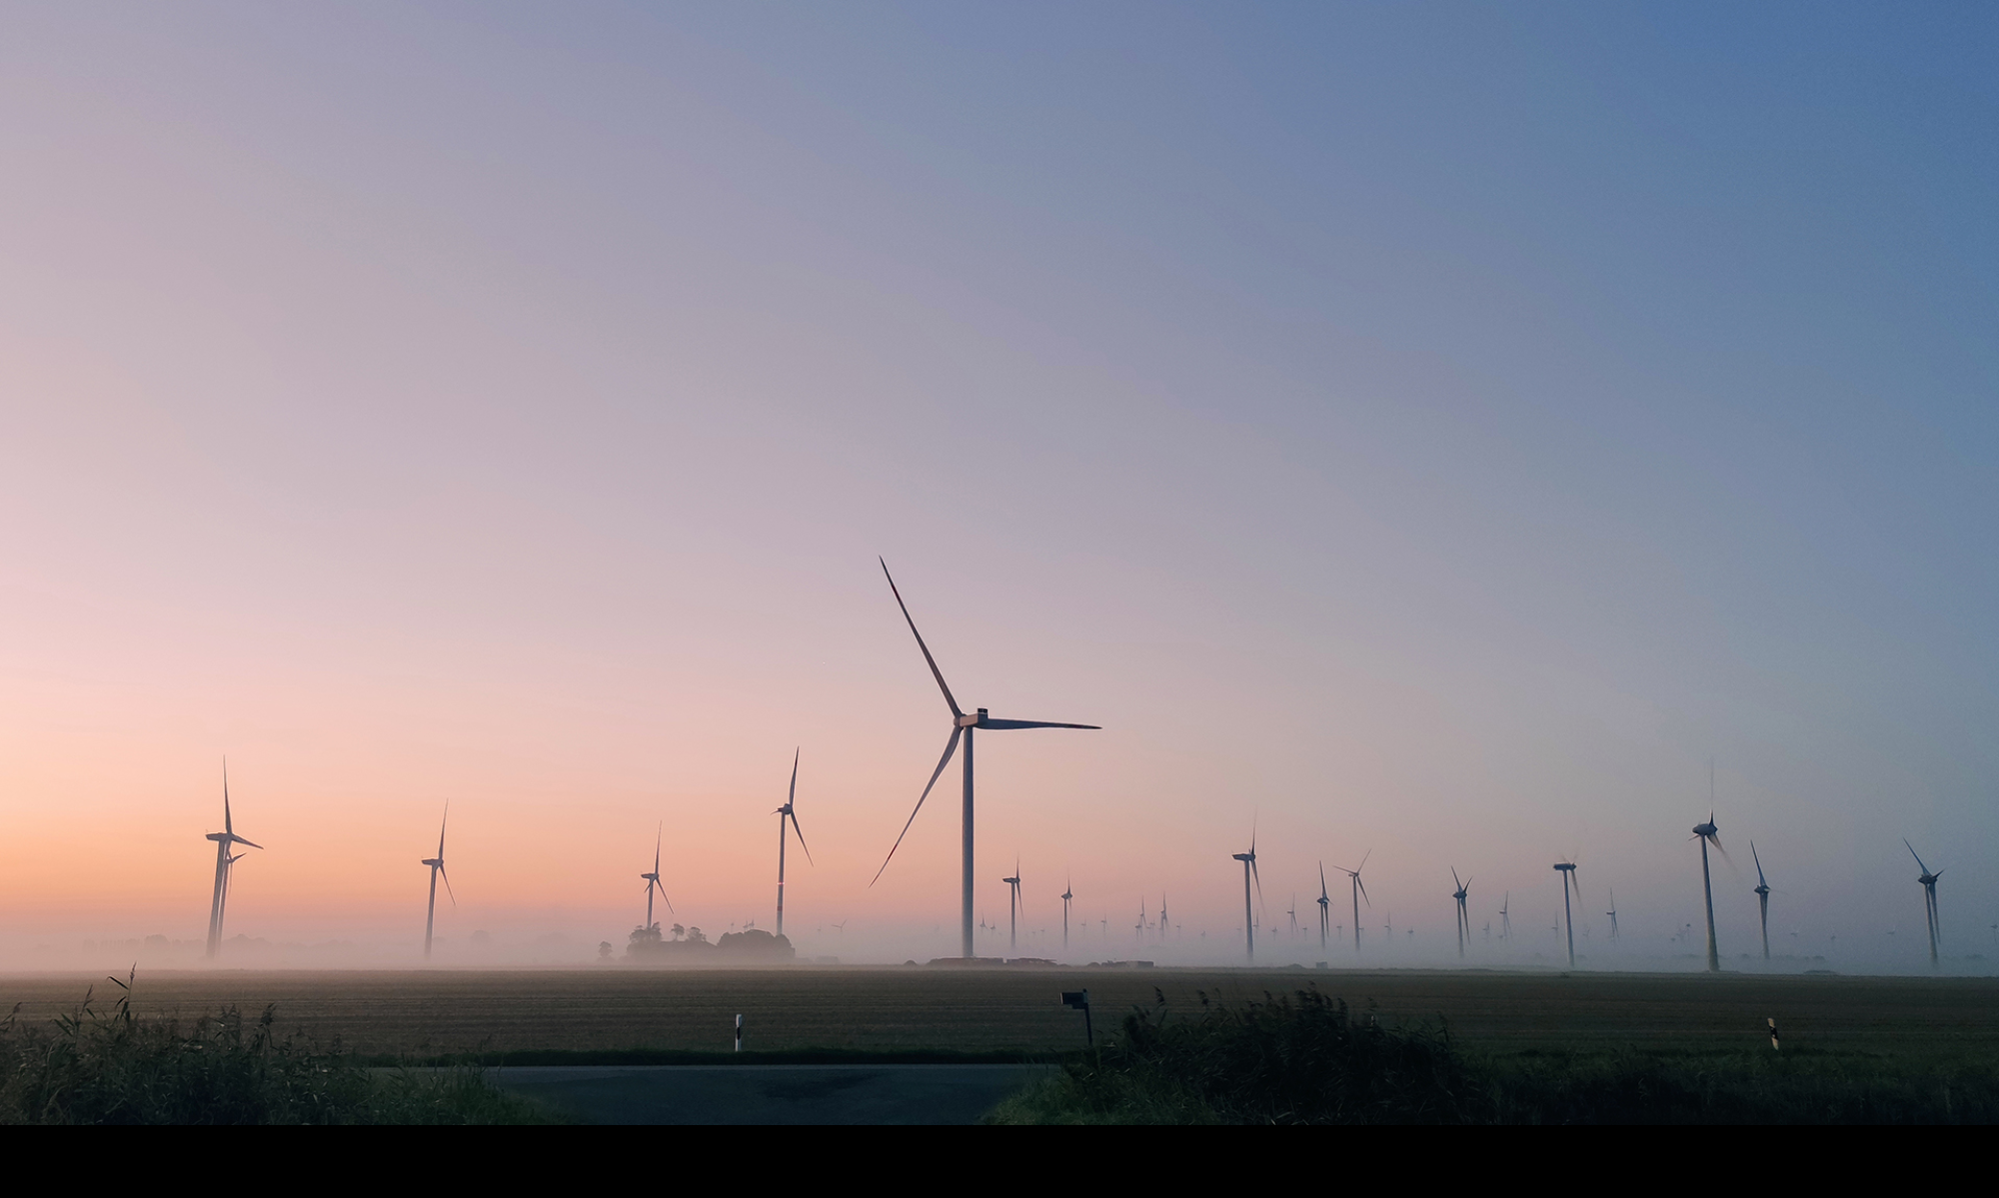
TOUBA WATER PROJECT
TERRA 21 ENERGY
Dipl. Ing. Jürgen Sieling Touba, 20 October 2025

Slide 2
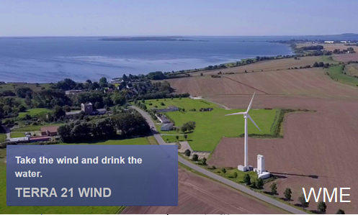
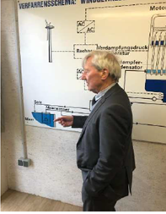
Touba water project – water supply for Touba
WME technology
TERRA 21 ENERGY
up to 200.000 m³ drinking water / day
Sustainable water supply for Touba region
Financing by the Al-Bader Group, Kuwait
TERRA 21 ENERGY as supplier and exporter
WME technology for large-scale drinking water production
The MVC (Mechanical Vapor Compression) distillation process is used. This is an energy-efficient process for water treatment through distillation, in which steam is compressed. This thermal evaporation process is ideal for separating water from impurities.

Slide 3
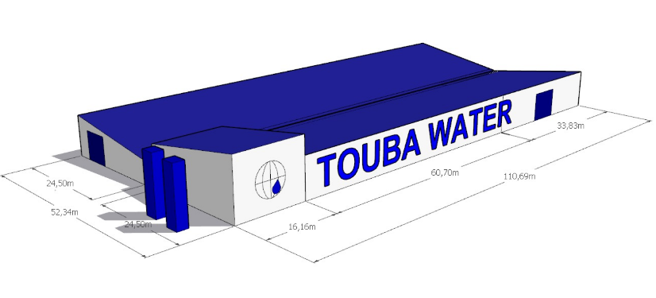

Touba water project – water supply for Touba
PoC project
Proof of Concept (PoC), starts immediately
up to 500 m³ drinking water / day (in 12 hours)
2 WME Seawater desalination plant, 40.000 Ltr/h
KRONES-line capacity of 25.000 bph still water (PET 0,5 ltr)
TERRA 21, construction production hall and warehouse
TERRA 21, solar 1.044 kWp + battery storage 2,4 MWh
PoC project , commissioning of plant in june 2026
TERRA 21 ENERGY
Supplying the mosque with clean drinking water

Slide 4
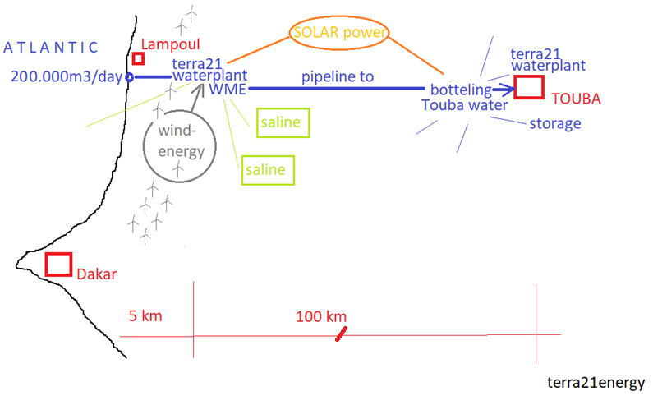
Touba water project – water supply for Touba
In the 3. year of the project, pipeline construction from Atlantic to Touba
pipeline construction
TERRA 21 ENERGY
Feasibility study A water supply for Touba with up to 200,000 m³ of drinking water per day is to be implemented in the coming years. The TERRA 21 ENERGY feasibility study has developed the following system solution: o Construction of seawater desalination plants using Atlantic water o Energy generation through solar, wind and biogas plants o Installation of pipelines and pump systems o Bottling station by KRONES o Production of table salt Up to 40 water desalination plants with energy systems are to be delivered annually and built gradually.

Slide 5
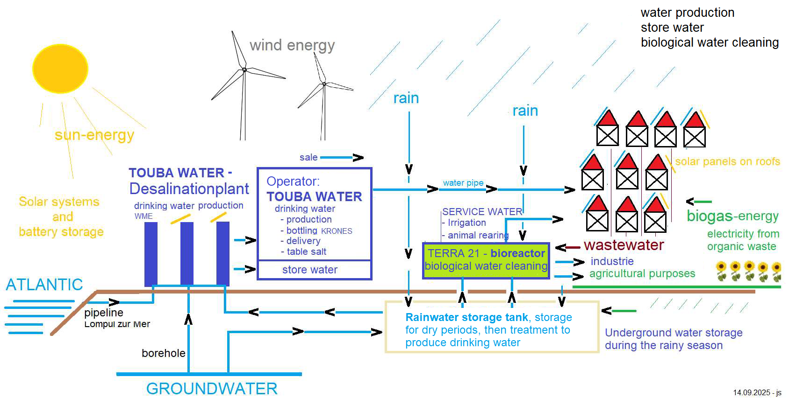
Touba water project – water supply for Touba
Water cycle, with renewable energy
water cycle
TERRA 21 ENERGY

Slide 6
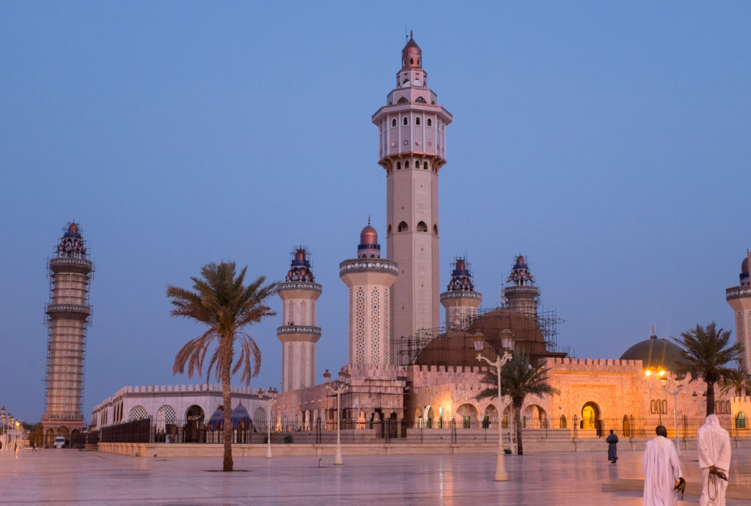
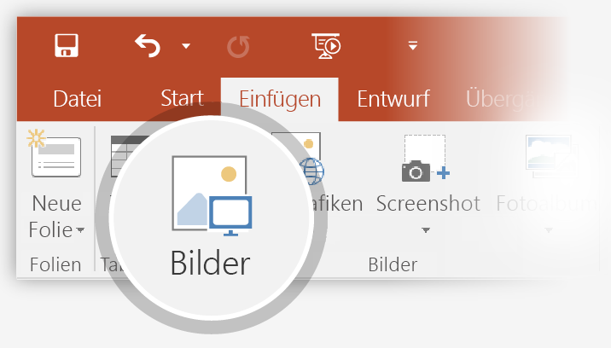
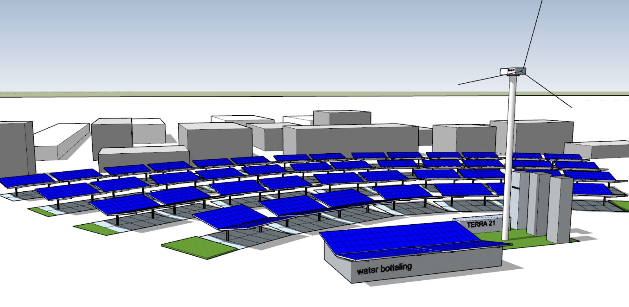
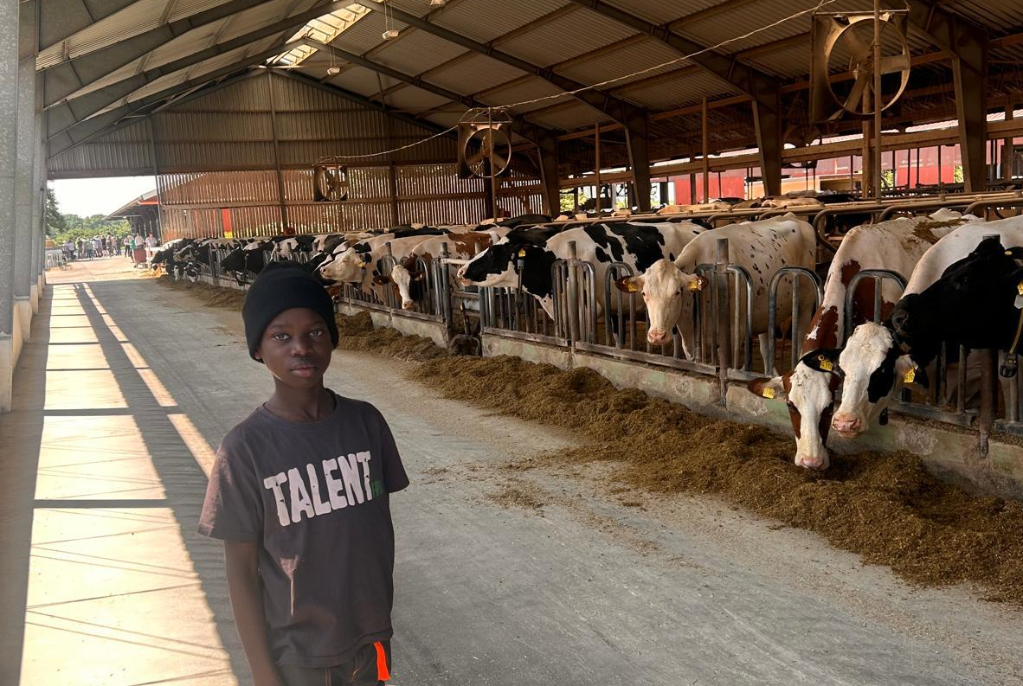
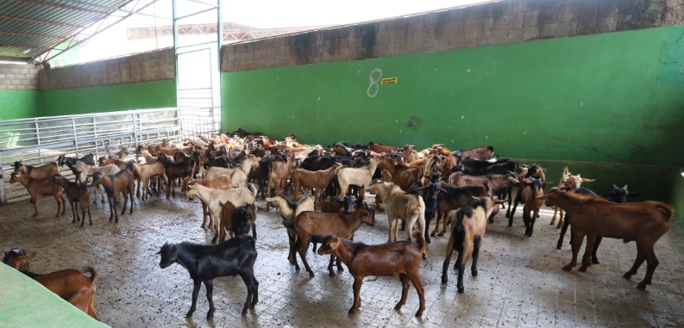
Project planning and development
Touba Water project
Project planning for continuous development begins
Phase 1 -Proof of Concept (PoC) - Location Touba demonstrate the technical and economic viability of seawater distillation Components: 2 WME-distillation plants: 44 m³/h (44.000 ltr/h), up to 500 m³ drinking wager per day Solar power 1044 kWp + battery storage 2,4 MWh - self-sufficient power supply KRONES bottling plant 25.000 bph, PET 0,5 ltr This pilot plant lays the foundation for rapid expansion throughout the country.
1
Phase 2 – Year One: Deployment and Water Park Scale-Up Components: 6 distillation plants WME: 132 m³/h (132.000 ltr/h) Solar power: 2 MWp + battery storage + windcraft
2
3
Phase 3 – Annual Expansion Plan 18 New Desalination Plants annually capacity: 400 m³/h (400,000 ltr/hour) KRONES bottling plant 100.000 bph with logistics for delivery Full energy autonomy and integrated infrastructure.
Phase 4 – Project planning for large-scale water supply, self-sufficient energy supply Water supply for all houses, cleaning used water, construction of biogas plants and wind parks. Delivery of up to 40 water systems per year. “Implementing the water cycle” Start agricultural production dairy farming with year-round water supply. Dairies, slaughterhouses, and cold storage facilities are being built.
4

Slide 7
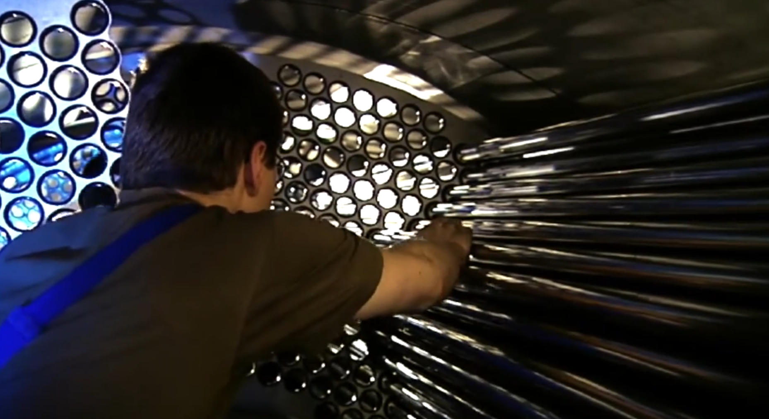
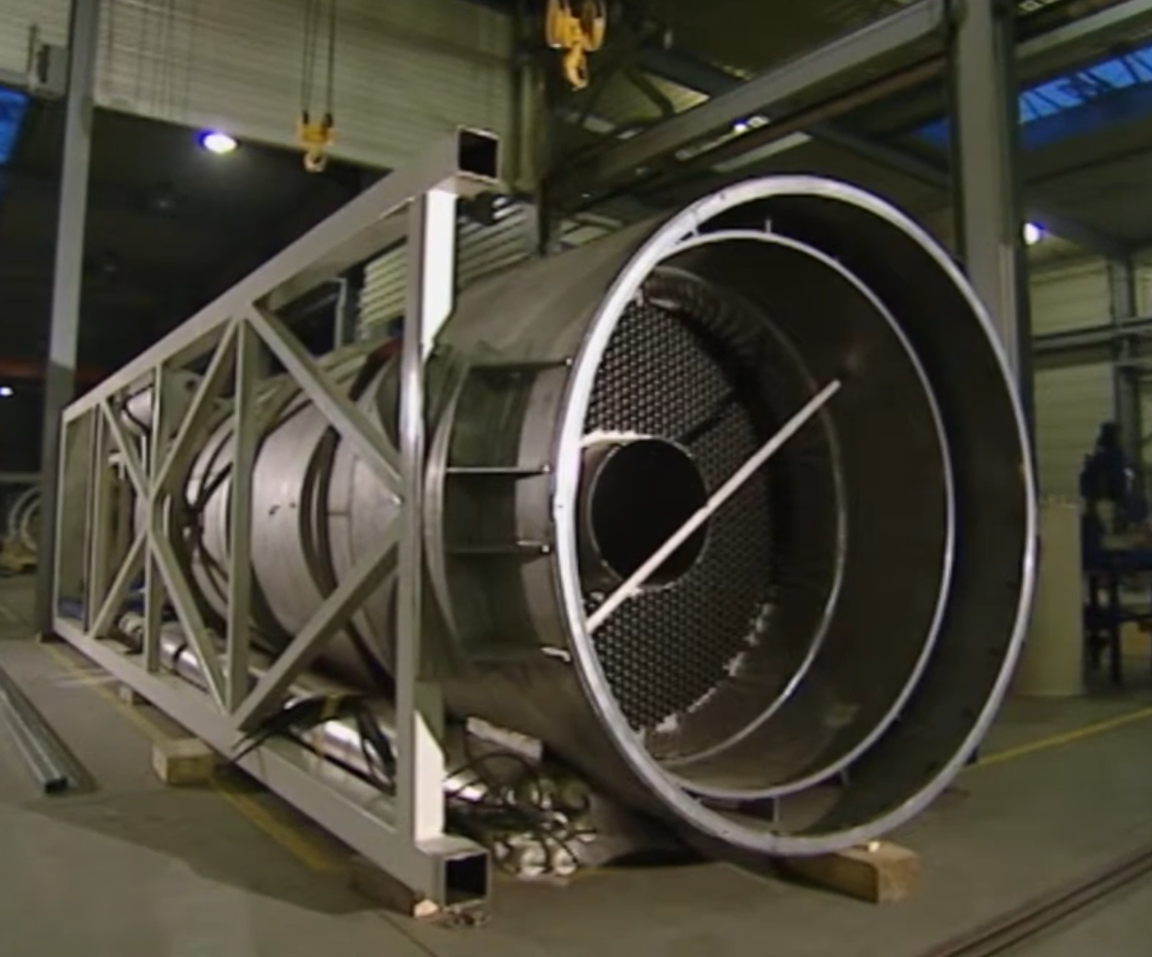
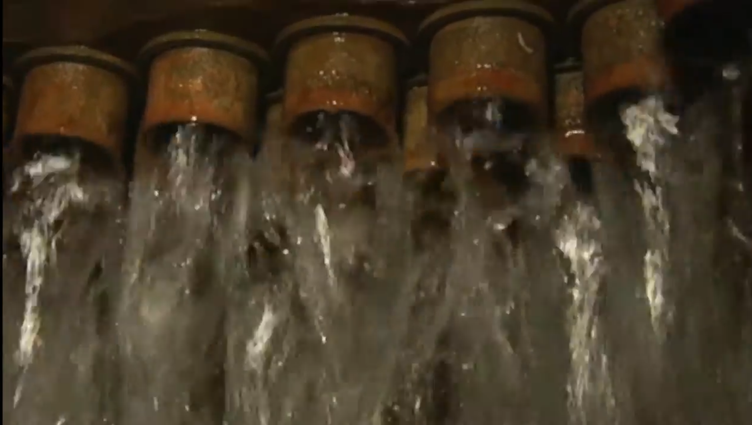
Touba water project – water supply for Touba
WME
WME, water distillation plant for the PoC project
up to 500 m³ drinking water / day (with 12 hours solar power in daytime)
Production of 100% clean drinking water in large quantity
The MVC (Mechanical Vapor Compression) distillation process is used
Energy efficient and environmentally friendly, no chemicals
Basis for the production of hydrogen
PoC project , commissioning of plant plant in June 2026
TERRA 21 ENERGY
WME`s Desalination Technology

Slide 8
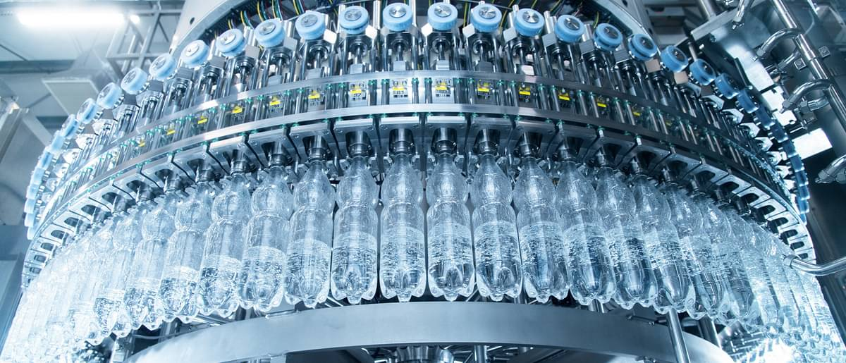
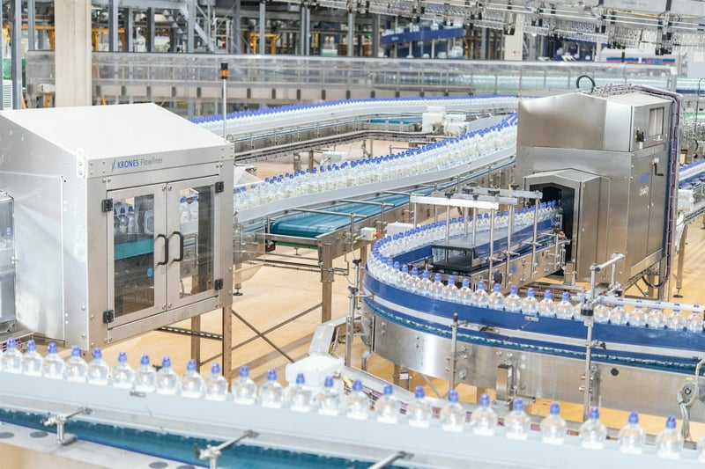
Touba water project – water supply for Touba
KRONES AG
KRONES, bottling
KRONES-line capacity of 25.000 bph still water 0,5
Highly efficient systems featuring the latest technology, high performance, energy efficient
Training on all equipment, 24/7 support
The following plants will have a capacity of up to 100,000 bph. Bottling of juices, milk and hot beverages
PoC project , commissioning of plant in June 2026
TERRA 21 ENERGY
KRONES - PET line

Slide 9
Touba water project – water supply for Touba
IN BEAREITUNG
ENERGY SUPPLEY, text
Solar 1044 kWp Batteriestorage 2,4 MWh
text
in BEARBEITUNG
text
PoC project , commissioning of plant in june 2026
TERRA 21 ENERGY
text

Slide 10
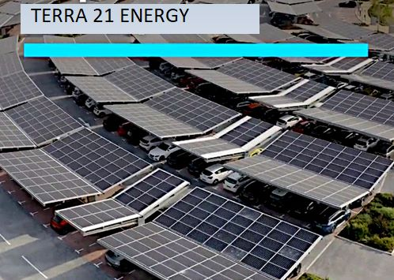
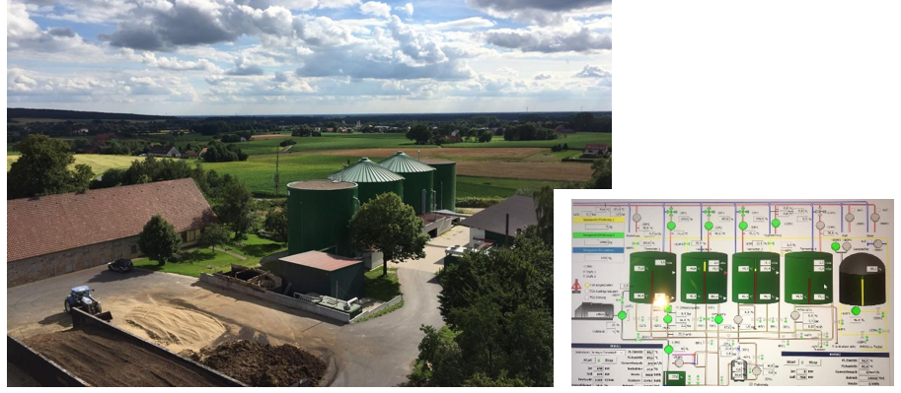
Touba water project – water supply for Touba
IN BEARBEITUNG
follow-up projects, text
In Bearbeitung
Biological water cleaning in a TERRA 21 BIOREACTOR
Project in agriculture
Energieversorgung Stromnetzausbau
Biogas (GESONDERTE FOLIEN)
the process starts, Project teams manage development
TERRA 21 ENERGY
text

Slide 11
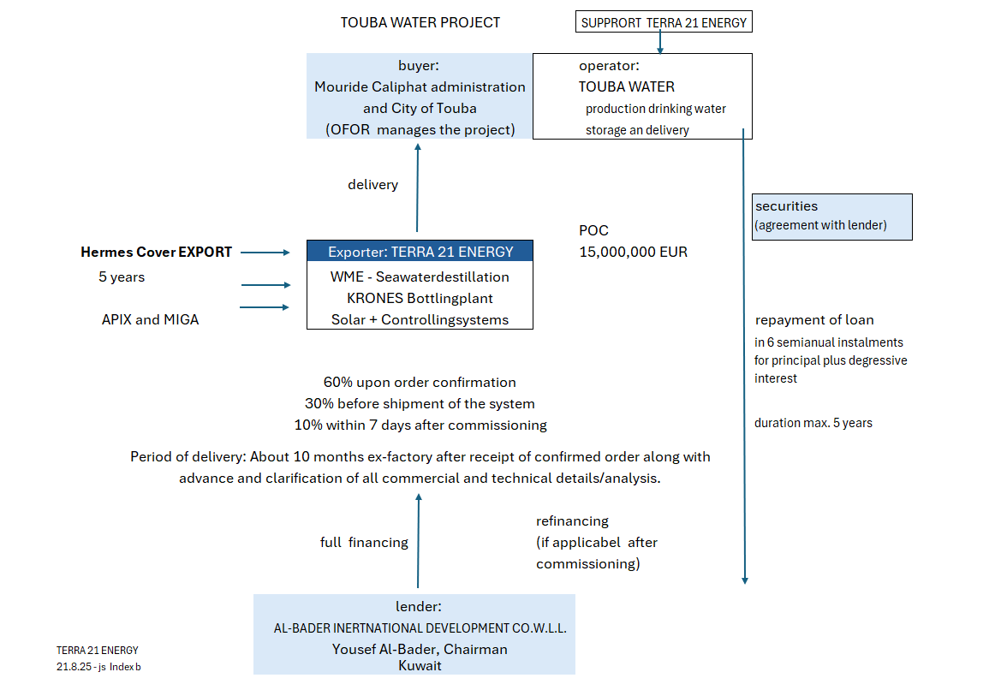
Touba water project – water supply for Touba
financing
PoC project financing
TERRA 21 ENERGY
3
2
1

Slide 12
Touba water project – water supply for Touba
IN BEARBEITUNG
TERRA 21 ENERGY
Zusammenfassung - Ausblick
text
Financing by the Al-Bader Group, Kuwait
TERRA 21 ENERGY as supplier and exporter
WME technology for large-scale drinking water production
TEXT

Slide 13
Cette présentation peut être consultée à l'adresse suivante : This presentation can be found at: Merci beaucoup pour votre intérêt. TERRA 21 ENERGY
hu4.eu/water

